Slide 1
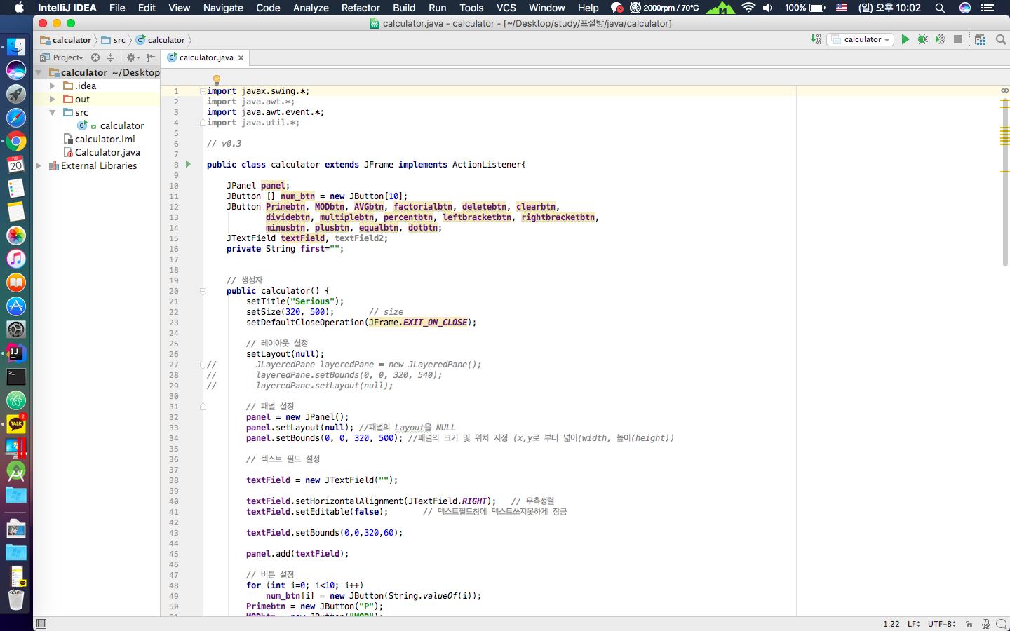
Open-Source SW
#28 - simpsons

Slide 2
Contents
Project
Calculator
Github
Role
Serious
Next

Slide 3
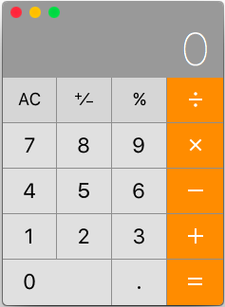
Project
?
Serious
Calculator -
JAVA Desktop App

Slide 4
Role
Development
Translation
Reading
Design
Algorithm
Maintain
Documentation
Management
Park
Collaboration
Seo

Slide 5
Calculator
General Function
+
Plus
-
Minus
x
Multiply
/
Division
%
Percent

Slide 6

Serious
NEW Function
P
Distinction Prime number
MOD
Remainder
AVG
Average
!
Factorial

Slide 7
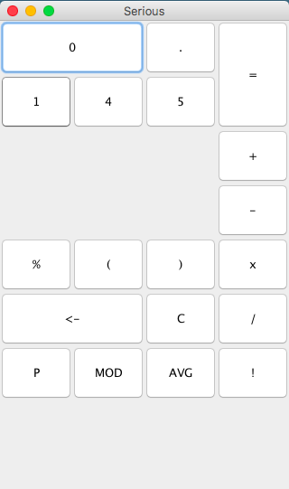
Serious v0.1
Make a Frame
Title
Button

Slide 8
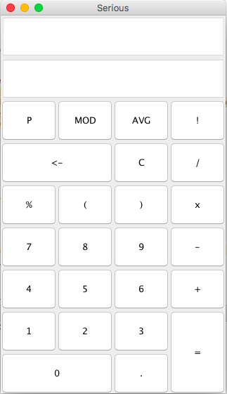
Serious v0.2
Add
Text field
Button
Set Location

Slide 9
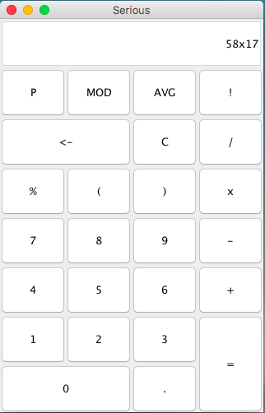
Serious v0.3
Add
Input function
Delete
Text field

Slide 10
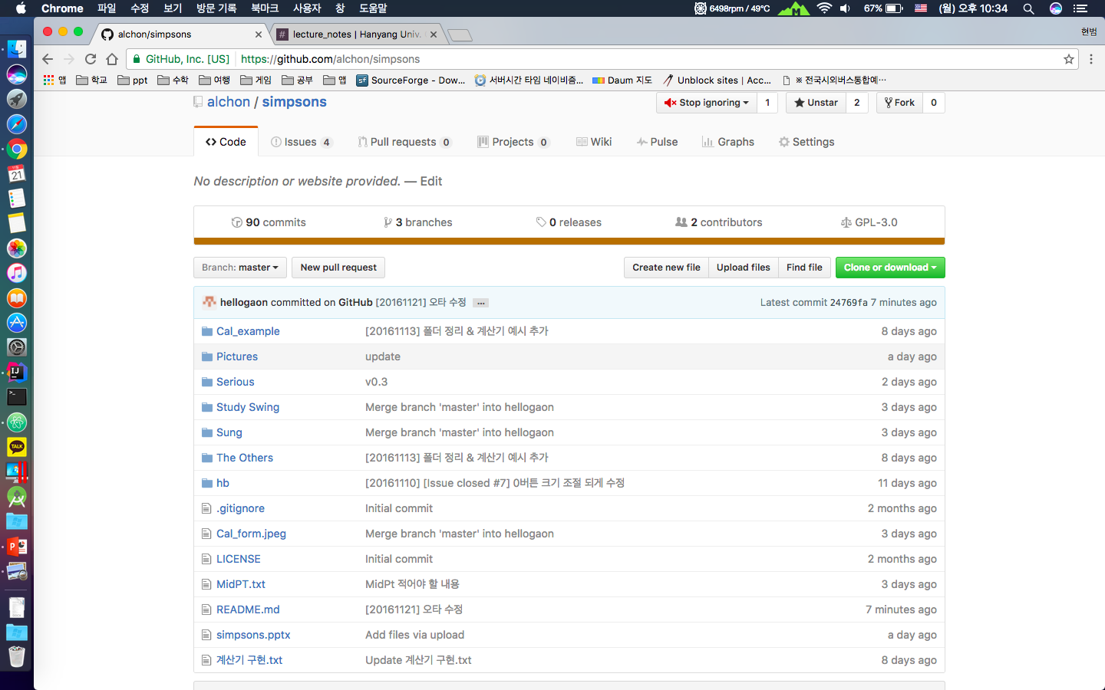
Github

Slide 11
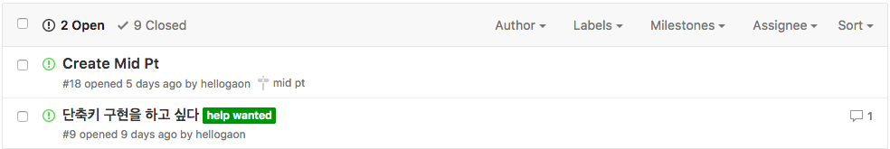
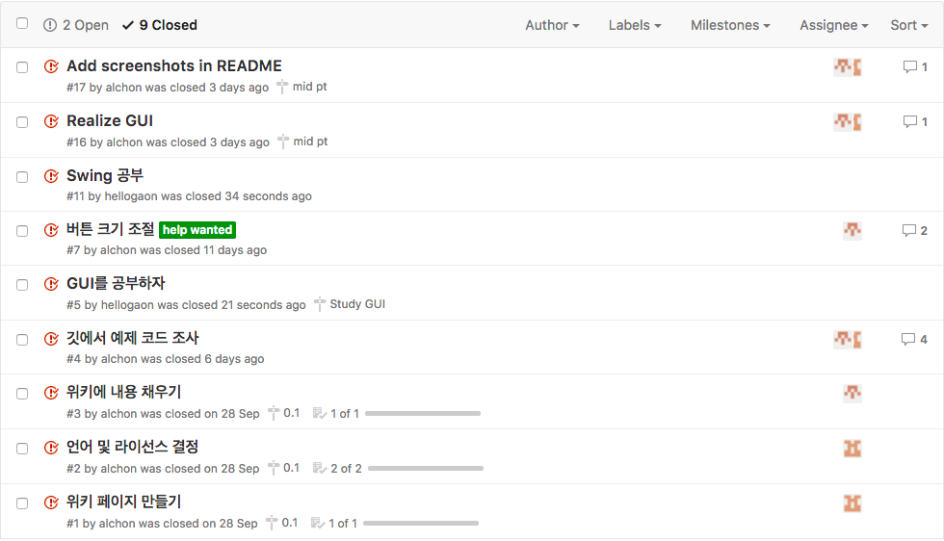
Github - Issue

Slide 12
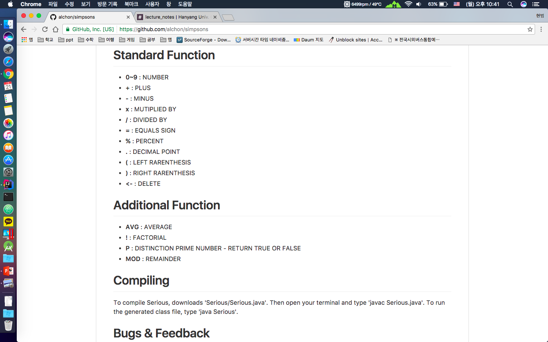
Github - README
Https://github.com/alchon/simpsons

Slide 13
Serious - Next
Next Version
Calculate
Menu bar
Hotkey
Design
And so on …

Slide 14
THANK YOU!

